Slide 1



KONGUNADU COLLEGE OF ENGINEERING AND TECHNOLOGY
(AUTONOMOUS)
Tholurpatti (P.O), Thottiam –T.K, Trichy – 621 215.
Department of Electronics and Communication Engineering
HX8001 - PROFESSIONAL READINESS FOR INNOVATION, EMPLOYABILITY AND ENTREPRENEURSHIP
REAL-TIME RIVER WATER QUALITY MONITORING AND CONTROL SYSTEM
Domain of the Project : Internet of Things
Batch ID : B12-6A2E
Team ID : PNT2022TMID13544
Academic Year : 2022-2023
Year/Semester : IV/VII
Team Members:
NIVETHA.M(621319106063)
SAJITHA.R(621319106078)
SORNAMALYA.B(621319106091)
VAISHNAVI.K(621319106097)
Mentor:
Dr.T.Yuvaraja

Slide 2
Table of Contents
S.No. | Content | Slide No.
1 | Objectives
2 | Abstract
3 | Introduction
4 | Literature Survey
5 | Problem Identification
6 | Block Diagram
7 | References

Slide 3
Objectives
The main aim is to develop a system for continuous monitoring of river water quality at remote places using wireless sensor networks with low power consumption, low-cost and high detection accuracy pH, conductivity, humiditity level, etc.

Slide 4
Abstract
Water is a vital resource for life.however, although most of the planet is covered with water, only a small percentage corresponds to fresh water. Also, a low percentage of fresh water corresponds to drinking water, that is, water useful for human consumption.
This paper presents a systematic literature review on the various modern mechanisms to monitor water quality, through the use of technology to take measurements of dust particals and PH value.

Slide 5
Introduction
Water is a vital resource for human health. Although around 71% of the world is covered with water, only 2.5% corresponds to fresh water. In developing countries, 80% of the population has no access to fresh water.
To ensure that the water quality complies with the required characteristics it is necessary to have systems that monitor the corresponding parameters like PH value , Temperature and validate that they are within the acceptable ranges.

Slide 6
Literature Survey
TITLE | AUTHOR & YEAR | JOURNAL NAME | REMARKS
Disabled people using DTMF technology | Krishna Kumar & 2016 |  | This project doesn’t approaches the work effectively in the problem addressed, where the remote has to be touched by many people. Nowadays, the web need to wound up a typical interface that countless contraptions use to set up will improve the regular daily existence of various people..

Slide 7
Literature Survey
TITLE | AUTHOR & YEAR | JOURNAL NAME | REMARKS
Water Quality Monitoring for Rural Areas-A Sensor Cloud Based Economical Project.” | Nikhil Kedia & 2020 |  | Published in International Conference on Next Generation Computing Technologies Dehradun, India. This paper highlights the entire water quality monitoring methods, sensors, embedded design, and information dissipation procedure, role of government, network operator and villagers in ensuring proper information dissipation. It also explores the Sensor Cloud domain. While automatically improving the water quality is not feasible at this point, efficient use of technology and economic practices can help improve water quality and awareness among people

Slide 8
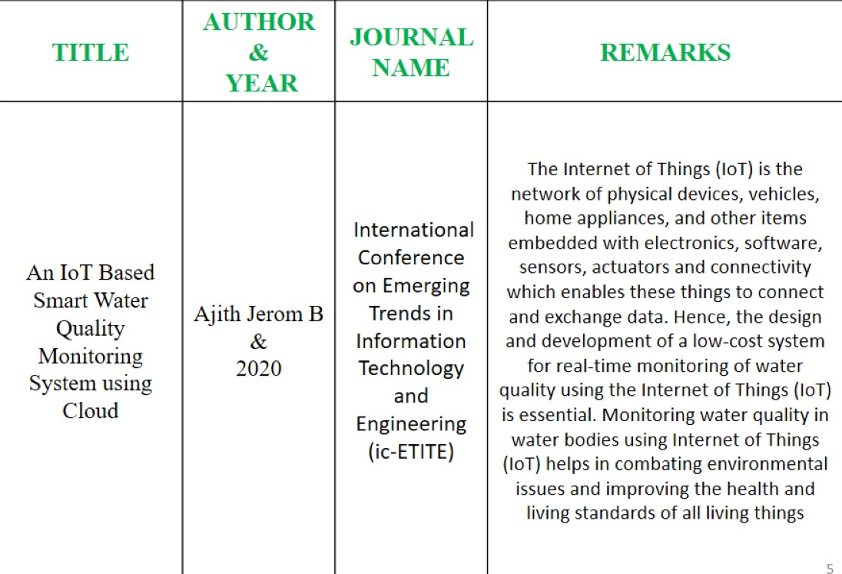
Literature Survey

Slide 9
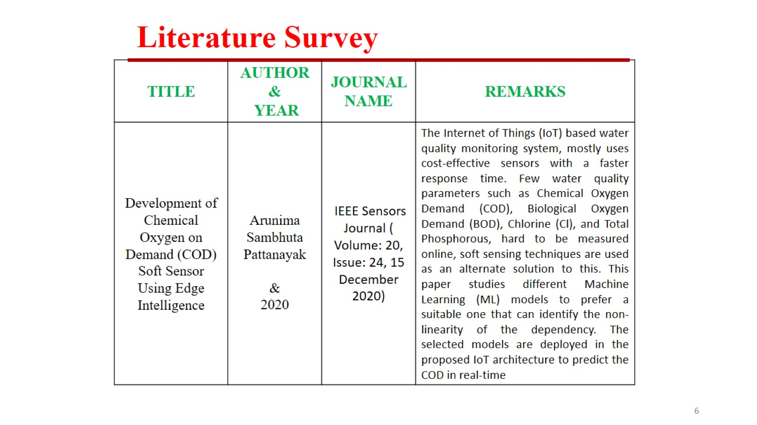
Literature Survey

Slide 10
Literature Survey
TITLE | AUTHOR & YEAR | JOURNAL NAME | REMARKS
“Real Time Water Quality Monitoring System” | Jayti Bhatt,Jignesh Patoliya & 2021 |  | This paper describes to ensure the safe supply of drinking water the quality should be monitored in real time for that purpose new approach IOT (Internet of Things) based water quality monitoring has been proposed. In this paper, we present the design of IOT based water quality monitoring system that monitor the quality of water in real time. This system consists some sensors which measure the water quality parameter such as pH, turbidity, conductivity, dissolved oxygen, temperature. The measured values from the sensors are processed by microcontroller and this processed values are transmitted remotely to the core controller that is raspberry pi using Zigbee protocol. Finally, sensors data can view on internet browser application using cloud computing.

Slide 11
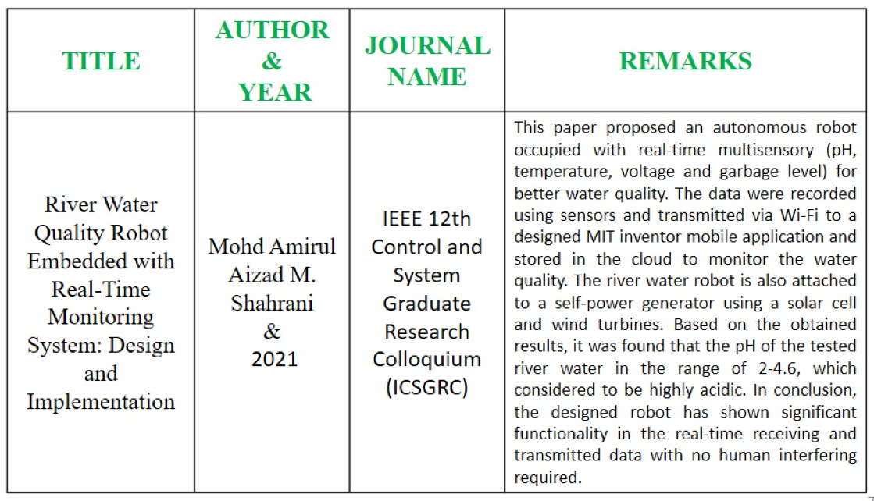
Literature Survey

Slide 12
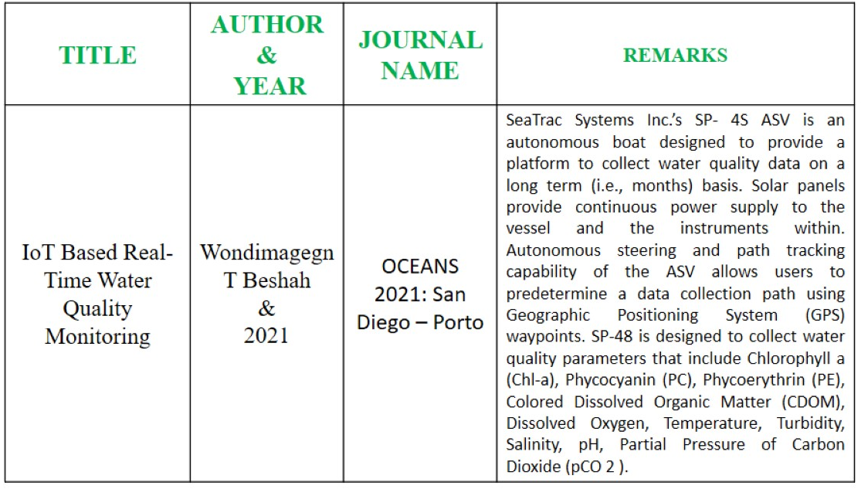
Literature Survey

Slide 13
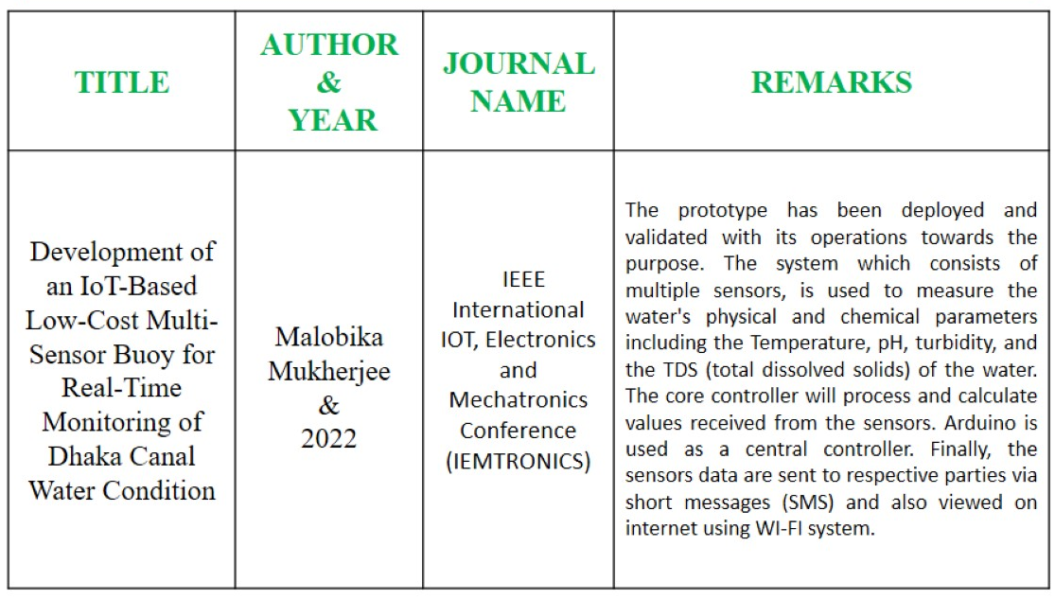
Literature Survey

Slide 14
Problem Identification
To design a good quality model, we reviewed out different existing system developed by researchers.
Different authors have proposed distinguished models to check water quality by analyzing the parameters such as temperature, pH and conductivity, and so on.
By considering all these points, we designed a smart water monitoring system which can perform all these monitoring functions.

Slide 15
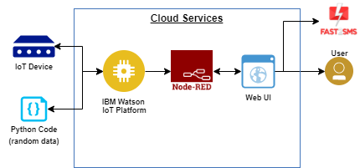
Block Diagram

Slide 16
References
K. S. Adu-Manu, C. Tapparello, W. Heinzelman, F. A. Katsriku, and J.-D. Abdulai, "Water quality monitoring using wireless sensor networks: Current trends and future research directions," ACM Transactions on Sensor Networks (TOSN), vol. 13, p. 4, 2017.
B. Chen, Y. Song, T. Jiang, Z. Chen, B. Huang, and B. Xu, "Real-time estimation of population exposure to PM2.5 using mobile- and station-based big data," Int J Environ Res Public Health, vol. 15, Mar 23 2018.
B. Paul, "Sensor based water quality monitoring system," BRAC University, 2018.
K. Andersson and M. S. Hossain, "Smart Risk Assessment Systems using Belief-rule-based DSS and WSN Technologies", in 2014 4th International Conference on Wireless Communications, Vehicular Technology, Information Theory and Aerospace and Electronic Systems, VITAE 2014 : Co-located with Global Wireless Summit, Aalborg, Denmark 11-14 May 2014.

Slide 17
References
K. Andersson and M. S. Hossain, "Heterogeneous Wireless Sensor Networks for Flood Prediction Decision Support Systems", in 2015 IEEE Conference on Computer Communications Workshops (INFOCOM WKSHPS) : 6th IEEE INFOCOM International Workshop on Mobility Management in the Networks of the Future World, 2015, pp. 133–137.
S. Thombre, R. U. Islam, K. Andersson, and M. S. Hossain, "Performance Analysis of an IP based Protocol Stack for WSNs", in Proceedings of the 2016 IEEE Conference on Computer Communications Workshops (INFOCOM WKSHPS), 2016, pp. 691–696.
M. Z. Abedin, A. S. Chowdhury, M. S. Hossain, K. Andersson, and R. Karim, "An Interoperable IP based WSN for Smart Irrigation Systems", presented at the 14th Annual IEEE Consumer Communications & Networking Conference, Las Vegas, 8-11 January 2017, 2017.
M. Z. Abedin, S. Paul, S. Akhter, K. N. E. A. Siddiquee, M. S. Hossain, and K. Andersson, "Selection of Energy Efficient Routing Protocol for Irrigation Enabled by Wireless Sensor Networks", in Proceedings of 2017 IEEE 42nd Conference on Local Computer Networks Workshops, 2017, pp. 75–81.

Slide 18
Questions & Discussion

Slide 19
THANK YOU

